Slide 1


University of Moratuwa Faculty of Engineering Department of Electronic and Telecommunication Engineering
Group Members:
210236P Jayakumar W.S.
210253N Jayathilaka C.B.N.L.
210254T Jayathilaka D.E.U.
210272V Karavita K.V.D.T.N.

Slide 2

SUPERSTART 1.0
Capacitive Jump Starter

Slide 3
Introduction
What is the product? An emergency survival kit that can be used to jump start vehicles.
1
Who will use it? Everyone who uses a personal vehicle for transportation
2

Slide 4
Product Justification
Based on a survey we conducted, it was clear most people have faced problems with jumpstarting their vehicles.
Just 12% have used a jump starter to solve their problem.
Due to this, people have wasted a lot of time by the roadside.
Additionally, it is extremely unsafe to stop the vehicle by the roadside, especially at night.

Slide 5
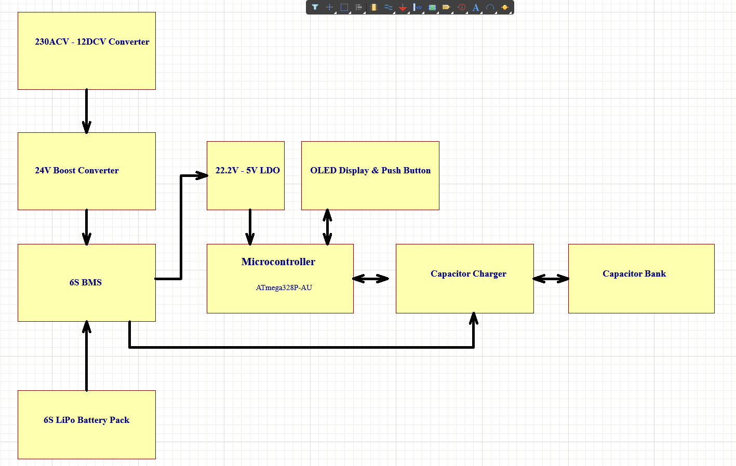
Product Architecture

Slide 6
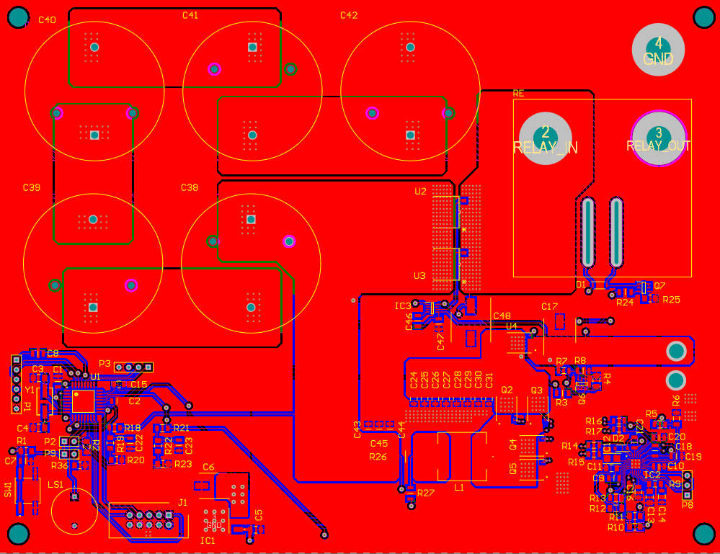
Images - PCB

Slide 7
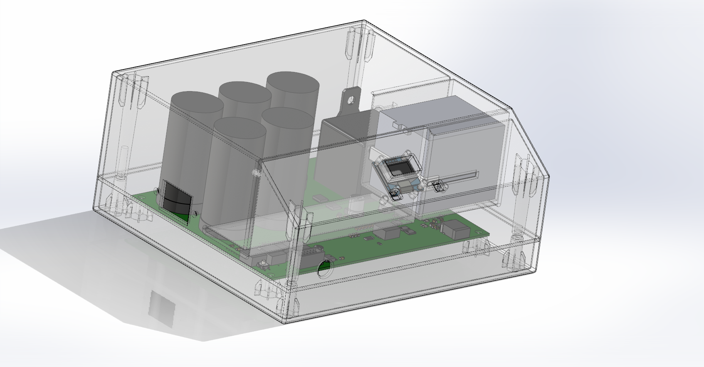
Images - Enclosure

Slide 8

Video Demonstration

Slide 9
Material Cost
Component | Quantity | Unit Price (Rs.) | Total (Rs.)
450F Capacitor | 5 | 800 | 4000
3S 11.1V LiPo Battery | 2 | 2000 | 4000
PCB | 1 | 500 | 500
Microcontroller | 1 | 500 | 500
Capacitor charging IC | 1 | 600 | 600
BMS | 1 | 800 | 800
12V Buck convertor | 1 | 500 | 500
OLED Display | 1 | 800 | 800
Enclosure |  | 6000 | 6000
Other Components |  | 500 | 12500
Total |  |  | 30000
Targeted Selling Price-Rs. 20,000
Total Cost – Rs.30,000

Slide 10
Differentiation
Longer lifetime due to the use of supercapacitors
Cheaper than other products in the market
Easy to use intuitive interface
Good after sales service

Slide 11
Task Allocation
JAYAKUMAR W.S. : Enclosure design, Circuit assembly and testing, PCB design
JAYATHILAKA C.B.N.L. : Circuit design, Electronic parts procurement, Assembly and testing
JAYATHILAKA D.E.U. : Circuit assembly and testing, UI programming, PCB design
KARAVITA K.V.D.T.N. : Circuit design, Circuit assembly and testing, UI programming

Slide 12

THANK YOU

